Slide 1
Machine Learning

Slide 2
Machine Learning
Machine learning(statistical learning, artificial intelligence) is a large set of tools and algorithms that are used to process and understand data.
Two types of machine learning:
supervised learning: algorithms that learn patterns/structures from labeled data(training examples) and then make predictions on new data. (e.g. neural network, linear/logistic regression)
unsupervised learning: algorithms that learn to find patterns/structures from unlabeled data.
reinforcement learning
Successful machine learning: not about algorithms. Algorithms have been around since the 80’s and 90’s.
data, data, data(labeled data)
computing power(GPU)
infrastructure(software)
Notes:
https://www.smartgrid.gov/the_smart_grid/smart_grid.html

Slide 3
IMAGENET
IMAGENET: database that provides “clean”, labeled images for machine learning algorithms.
Notes:
https://www.smartgrid.gov/the_smart_grid/smart_grid.html

Slide 4
Image Classification Challenge
competition that encourages researchers to compare progress on image recognition algorithms.
Notes:
https://www.smartgrid.gov/the_smart_grid/smart_grid.html

Slide 5
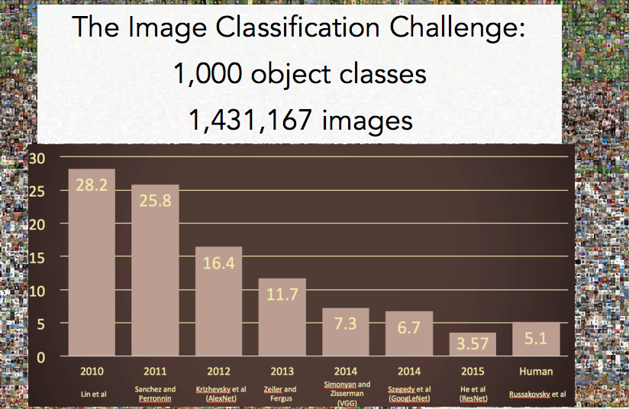
Error Rates
A major breakthrough occurred in 2012. A group of research scientist submitted a convolutional neural network(CNN) that demolishes the competition.
Notes:
https://www.smartgrid.gov/the_smart_grid/smart_grid.html

Slide 6
Identify these objects
Can you beat a computer by correctly identifying these objects?
Notes:
https://www.smartgrid.gov/the_smart_grid/smart_grid.html

Slide 7
Machine Learning
Important machine learning problems:
autonomous driving
natural language processing:
language translation
sentiment analysis(rate reviews on Amazon)
document similarity(search engines)
word2vec(Google)
GloVe(Stanford)
speech recognition(Siri, Alexa, Watson)
semantic analysis
question/answering(Siri, Alexa)
spam detection
name-entity extraction
Teddy Roosevelt was a US President.
Teddy bears are on sale!
Notes:
https://www.smartgrid.gov/the_smart_grid/smart_grid.html

Slide 8
Machine Learning
Important machine learning problems:
image recognition
face detection/recognition(Facebook)
image captioning
segmentation
object detection
medical prognosis
product recommendation(Amazon, Netflix)
credit card fraud detection
Notes:
https://www.smartgrid.gov/the_smart_grid/smart_grid.html

Slide 9
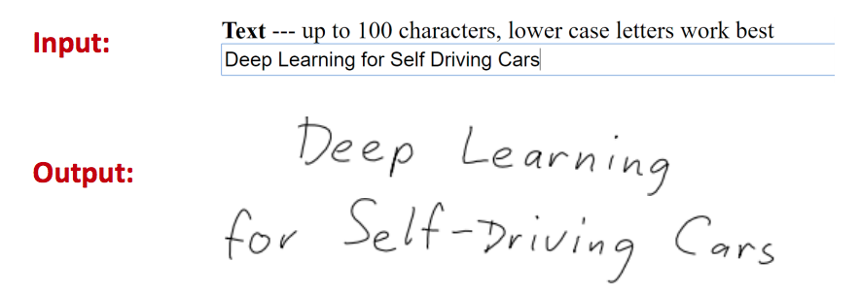
Identify the task
Identify the following computer task
Answer: handwriting generation
Notes:
https://www.smartgrid.gov/the_smart_grid/smart_grid.html

Slide 10
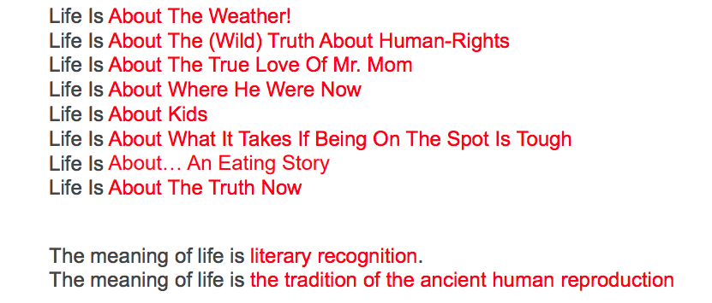
Identify the task
Identify the following computer task
Answer: (natural language processing: sentence completion)
Notes:
https://www.smartgrid.gov/the_smart_grid/smart_grid.html

Slide 11
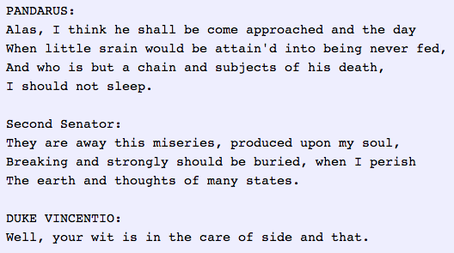
Identify the task(Generating Shakespeare)
Notice the model learns the character/dialogue format of Shakespeare. Andrej Karpathy of Stanford trained the neural network for several hours. (Recurrent Neural Network)
Notes:
https://www.smartgrid.gov/the_smart_grid/smart_grid.html

Slide 12
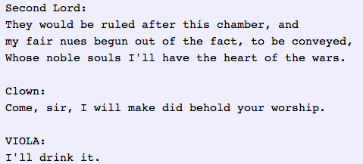
RNN Generating Shakespeare
This can
be done using:
1) N-grams:(easy)
2) RNN(recurrent
neural network):
much harder math
This text is
generated
one letter at
a time by an RNN.
Notes:
https://www.smartgrid.gov/the_smart_grid/smart_grid.html

Slide 13
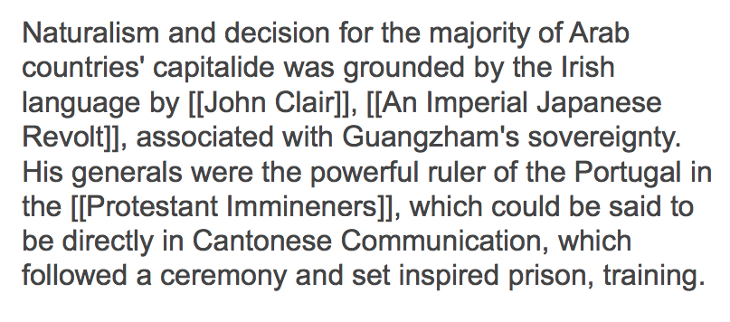
RNN Generating Wikipedia
A recurrent neural network was fed the entire Wikipedia corpus.
It generates sample text mimicking its language.
Amazingly, similar to the previous example with Shakespeare, it does this one letter at a time!!
Notes:
https://www.smartgrid.gov/the_smart_grid/smart_grid.html

Slide 14
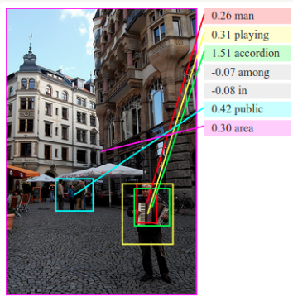
Identify the Task
Objects detection.
Notes:
https://www.smartgrid.gov/the_smart_grid/smart_grid.html

Slide 15
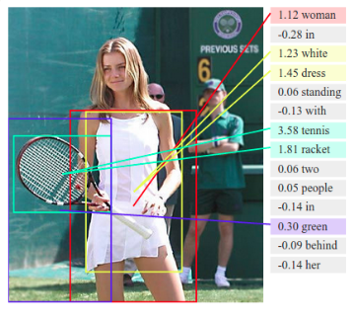
Amazing!
Notes:
https://www.smartgrid.gov/the_smart_grid/smart_grid.html

Slide 16
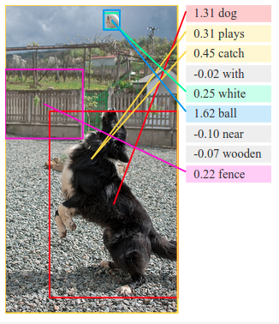
Another one
Notes:
https://www.smartgrid.gov/the_smart_grid/smart_grid.html

Slide 17
Identify the Task
image captioning.
Notes:
https://www.smartgrid.gov/the_smart_grid/smart_grid.html

Slide 18
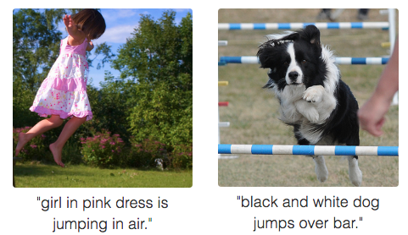
Image Captioning
Image captioning: objects recognition + natural language generation
Notes:
https://www.smartgrid.gov/the_smart_grid/smart_grid.html

Slide 19
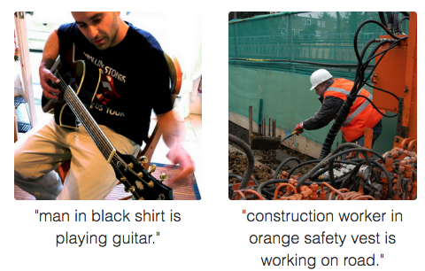
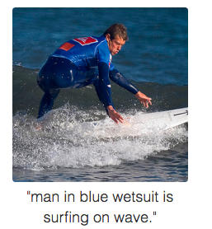
Image Captioning
Notes:
https://www.smartgrid.gov/the_smart_grid/smart_grid.html

Slide 20
Image Captioning
It doesn’t always get it right! Uses some probability.
Notes:
https://www.smartgrid.gov/the_smart_grid/smart_grid.html

Slide 21
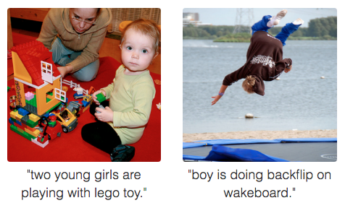
Image Captioning
It doesn’t always get it right! Uses some probability.
Notes:
https://www.smartgrid.gov/the_smart_grid/smart_grid.html

Slide 22
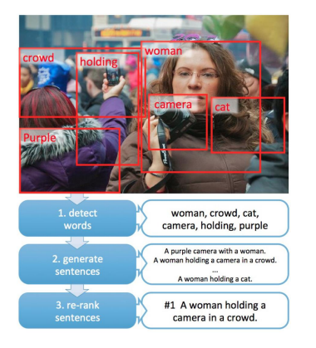
How does image captioning work?
1) Detect objects.
2) Recognize and generate
corresponding words.
3) Generate sentences and
assign probabilities based on
how likely that this is an
English sentence based on:
grammar
syntax
semantic meaning
4) Highest probability wins.
Notes:
https://www.smartgrid.gov/the_smart_grid/smart_grid.html

Slide 23
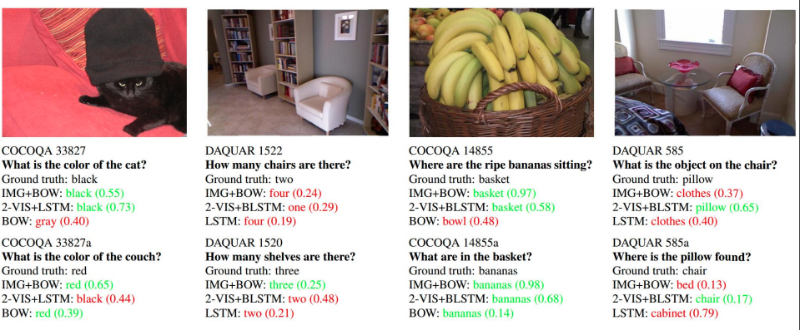
Image Question Answering
Notes:
https://www.smartgrid.gov/the_smart_grid/smart_grid.html

Slide 24
Have we solved the image recognition problem?
We have a long way to go.
Computers currently only “understand” images superficially.
true understanding:
prior knowledge
social contexts, cues
natural language comprehension
depth perception, object permanence, periphery vision(challenges of autonomous driving)
Consider the image on the next slide. Humans will immediately appreciate the humor. Computers won’t for a while.
Notes:
https://www.smartgrid.gov/the_smart_grid/smart_grid.html

Slide 25
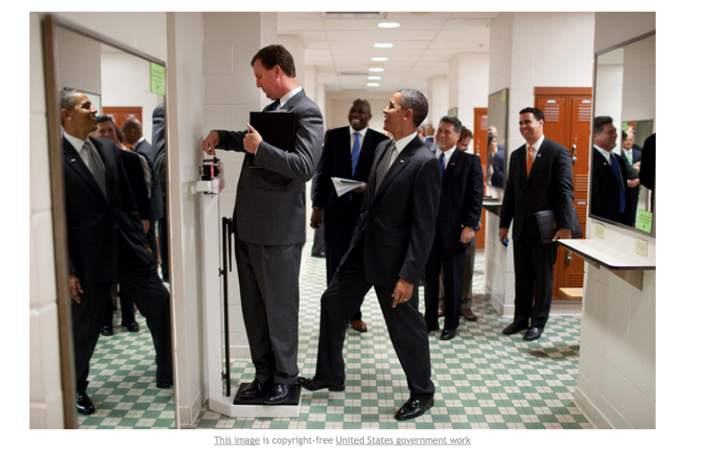
Can computers “understand” this picture?
Notes:
https://www.smartgrid.gov/the_smart_grid/smart_grid.html

Slide 26
More Challenges
Moravec’s Paradox: easy problems are “hard”.
walking, motion planning, opening a door knob, getting out of a car.
https://youtu.be/1L0TKZQcUtA?t=4289
computers can learn to play a video game by only looking at pixels on the screen.
very hard for robots to do basic tasks
playing soccer is really hard!
“Hard” problems are easy:
playing Chess, Go.
Google uses “deep learning”, neural network to create a program that can play at the superhuman level Chess, Go and Shogi. (Netflix documentary, AlphaZero, 2017)
Notes:
https://www.smartgrid.gov/the_smart_grid/smart_grid.html

Slide 27
Homework
1)Read and reread these lecture notes.
2)Watch(Required):
a) Machine Learning(PBS Studios Crash Course in CS)
https://www.youtube.com/watch?v=z-EtmaFJieY
b) Natural Language Processing(PBS Studios Crash Course in CS)
https://www.youtube.com/watch?v=fOvTtapxa9c

Slide 28
References
Justin Johnson, Andrej Karpathy. CS231N. Convolutional Neural Network for Visual Recognition.
http://cs231n.stanford.edu/
Lex Fridman, Introduction to Deep Learning and Self-Driving
Cars. https://www.youtube.com/watch?v=1L0TKZQcUtA

Slide 29
References
1) Part of this lecture is a recap of the following an episode from PBS Crash Course in Computer Science series.
PBS Crash Course in Computer Science. Cybersecurity. Retrieved from https://www.youtube.com/watch?v=bPVaOlJ6ln0
2) Computer Science E-1 at Harvard Extension School
Understanding Computers and the Internet by Tommy MacWilliam. Retrieved from http://cse1.net/video?v=lectures/6/lecture6

