Slide 1
Understanding Data Part 3
Extracting Information from Data

Slide 2
Information
Information is the collection of facts and patterns extracted from data. Data provide opportunities for identifying trends, making connections, and addressing problems.
The size of a data set affects the amount of information that can be extracted from it. A popular subfield of computer science is data science where large datasets are processed and analyzed.
Large data sets are difficult to process using a single computer and may require parallel or distributed systems. Scalability of systems is an important consideration when working with data sets, as the computational capacity of a system affects how data sets can be processed and stored.
Scalability is the ability of a system to handle a bigger load by adding resources to the system. For example, Amazon’s payment system is scalable because as its user base grows, it can add more servers to handle payments.
Notes:
Crash Course: Cybersecurity

Slide 3
Computational Models
Sequential computing is a computational model in which operations are performed in order one at a time.
Parallel computing is a computational model where the program is broken into multiple smaller sequential computing operations, some of which are performed simultaneously.
Parallel computing uses a single computer with multiple processors.
Distributed computing is a computational model in which multiple devices are used to run a program.
Notes:
Crash Course: Cybersecurity

Slide 4
Computational Models
A sequential solution takes as long as the sum of all of its steps. A parallel computing solution takes as long as its sequential tasks plus the longest of its parallel tasks.
The “speedup” of a parallel solution is measured in the time it took to complete the task sequentially divided by the time it took to complete the task when done in parallel.
Solutions that use parallel computing can scale more effectively than solutions that use sequential computing.
Distributed computing allows problems to be solved that could not be solved on a single computer because of either the processing time or storage needs involved. Distributed computing allows much larger problems to be solved quicker than they could be solved using a single computer.
Notes:
Crash Course: Cybersecurity

Slide 5
Information
Programs can be used to process data to acquire information.
Programs such as spreadsheets(for example, Excel) help efficiently organize and find trends in information. Excel can process tabular data or 2D data with mixed datatypes.
A powerful alternative is Python's pandas library. We will explore this library and see how it helps us:
gain insight and knowledge that are obtained from translating and transforming digitally represented information.
see patterns when data are transformed
filter, modify, combine and compare data
visualize data through charts, graphs, tables and other visualizations
We will use Jupyter Notebook(Lab) for all code in this lecture slides.
Notes:
Crash Course: Cybersecurity

Slide 6
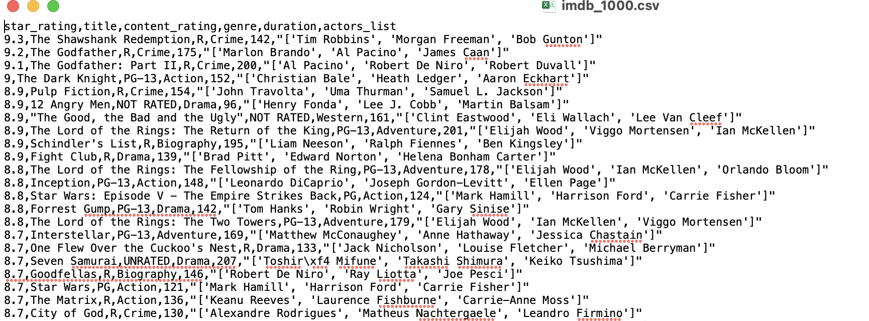
pandas
We'll explore pandas using Jupyter Lab by looking at a movies dataset: IMDB's Top 1000 movies. The “imdb_1000.csv” comma-separated values file is a text file that contains information about these movies.
Notes:
Crash Course: Cybersecurity

Slide 7
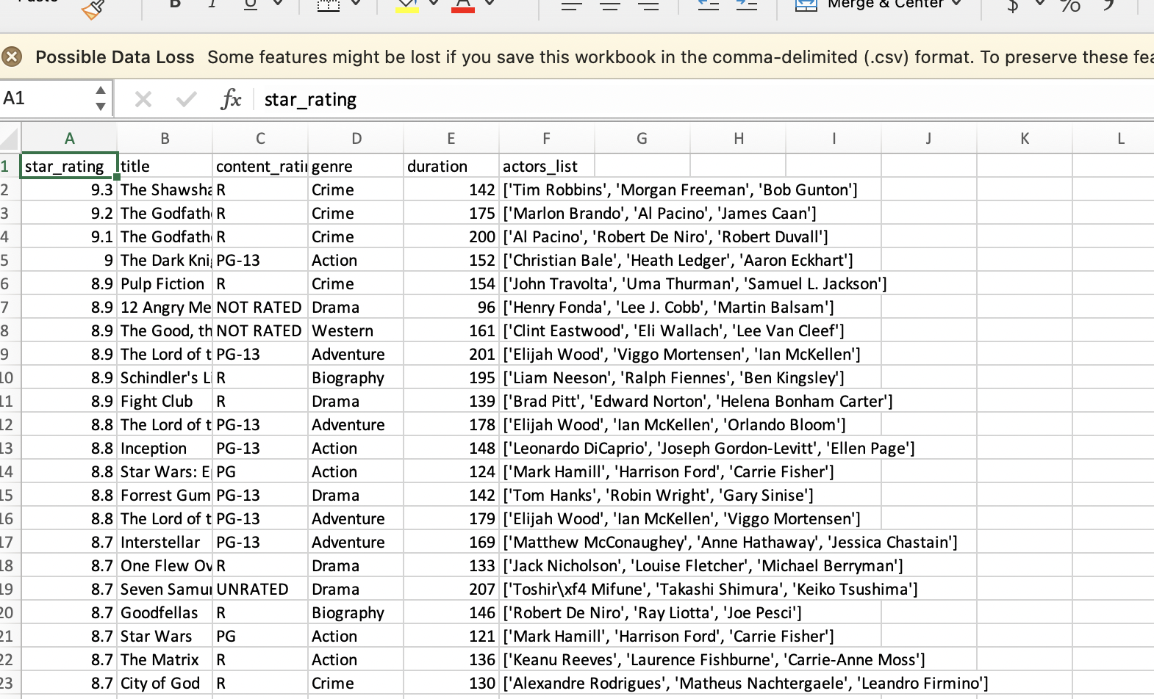
pandas
Opening this text file using Excel:
Notes:
Crash Course: Cybersecurity

Slide 8
pandas
Pandas can read in a csv file and store it as a dataframe, a 2D data structure.
Top five rows of the dataframe.
Notes:
Crash Course: Cybersecurity

Slide 9
Dataframe
The movies data structure in the previous slides is a dataframe. A dataframe is an enhanced two-dimensional data structure. You can think of it as a dictionary where the keys are the column names and the values are column values. Each column is called a Series.
Column names are like “keys” of a dictionary.
Column values are like “values” of a dictionary.
key
value
Notes:
Crash Course: Cybersecurity

Slide 10
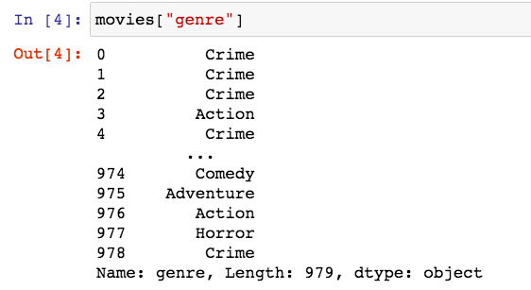
Accessing Columns of a Dataframe
To access a column of a dataframe, we use the same syntax as a dictionary, specifying the column name as the “key”.
You can select a column by using [] notation and
specifying the column name as a string.
This displays the "genre" Series.
Notes:
Crash Course: Cybersecurity

Slide 11
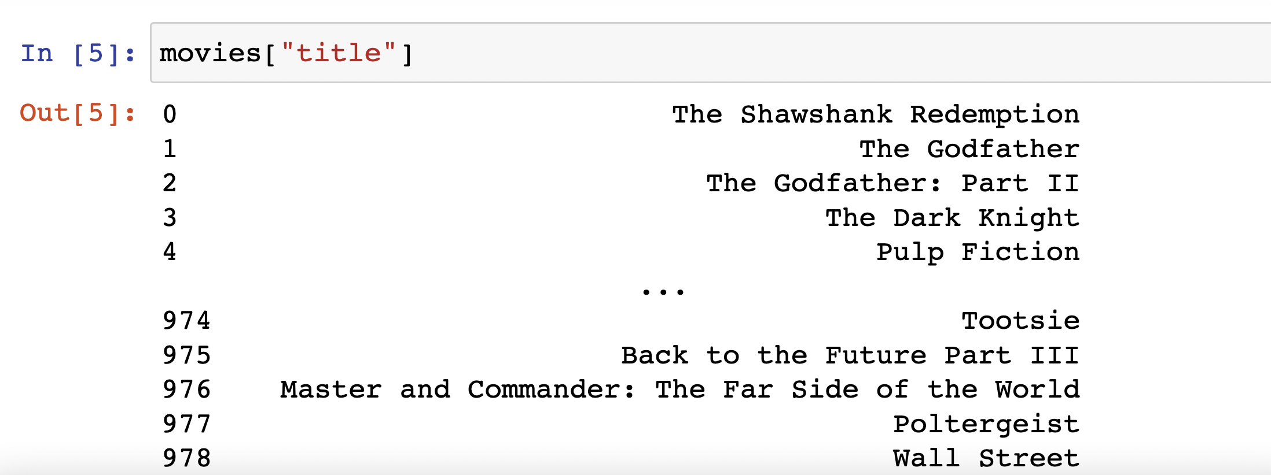
Accessing Columns of a Dataframe
Here’s another column in this dataframe called “title”.
You can select a column by using [] notation and
specifying the column name as a string.
This displays the "genre" Series.
Notes:
Crash Course: Cybersecurity

Slide 12
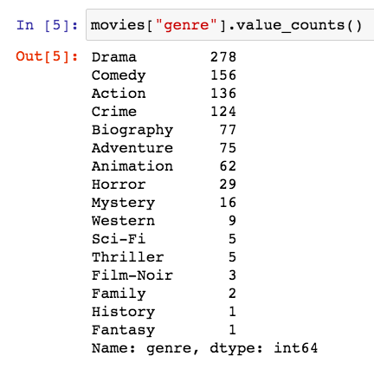
Analyzing Data
For categorical data like movies genre, the method value_counts() returns a columns(Series) containing counts of unique values.
For example, suppose I am interested
in investigating to see which of the
movies genre is most popular in the
top movies rated on IMDB.
Patterns can emerge when data are
transformed using programs.
# 1 genre is Drama!
Notes:
Crash Course: Cybersecurity

Slide 13
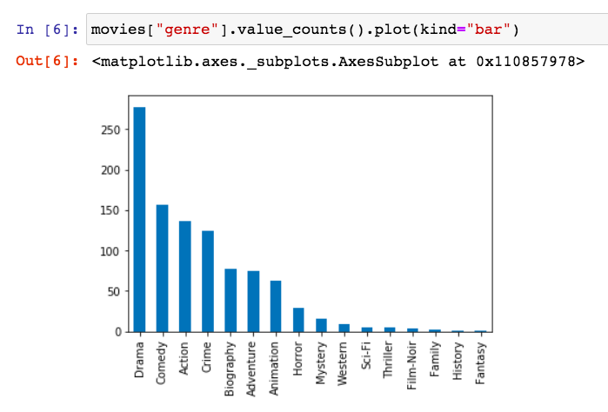
Plotting Data
Tables, charts, diagrams, text, and other visual tools can be used to communicate insight and knowledge gained from data.
The table of counts of unique values can be visually presented using pandas' plot function. We can specify the kind of graph with the "kind" optional parameter.
Notes:
Crash Course: Cybersecurity

Slide 14
Positional Index
The columns of a dataframe share the same row “index”. In this example, the index
is positional.
Positional index
Notes:
Crash Course: Cybersecurity

Slide 15
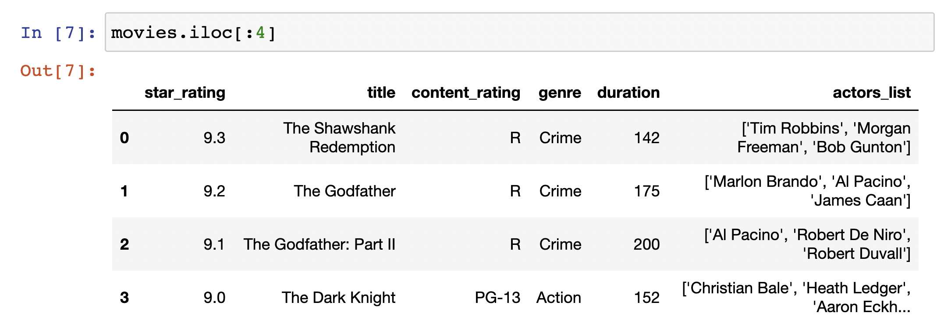
Accessing Rows with iloc
If the indexing is positional, .iloc[] notation allows us to access rows of a dataframe. For example, to get the top 4 rows of the dataframe:
slicing again!
When accessing rows, by default, pandas give us all columns
Notes:
Crash Course: Cybersecurity

Slide 16
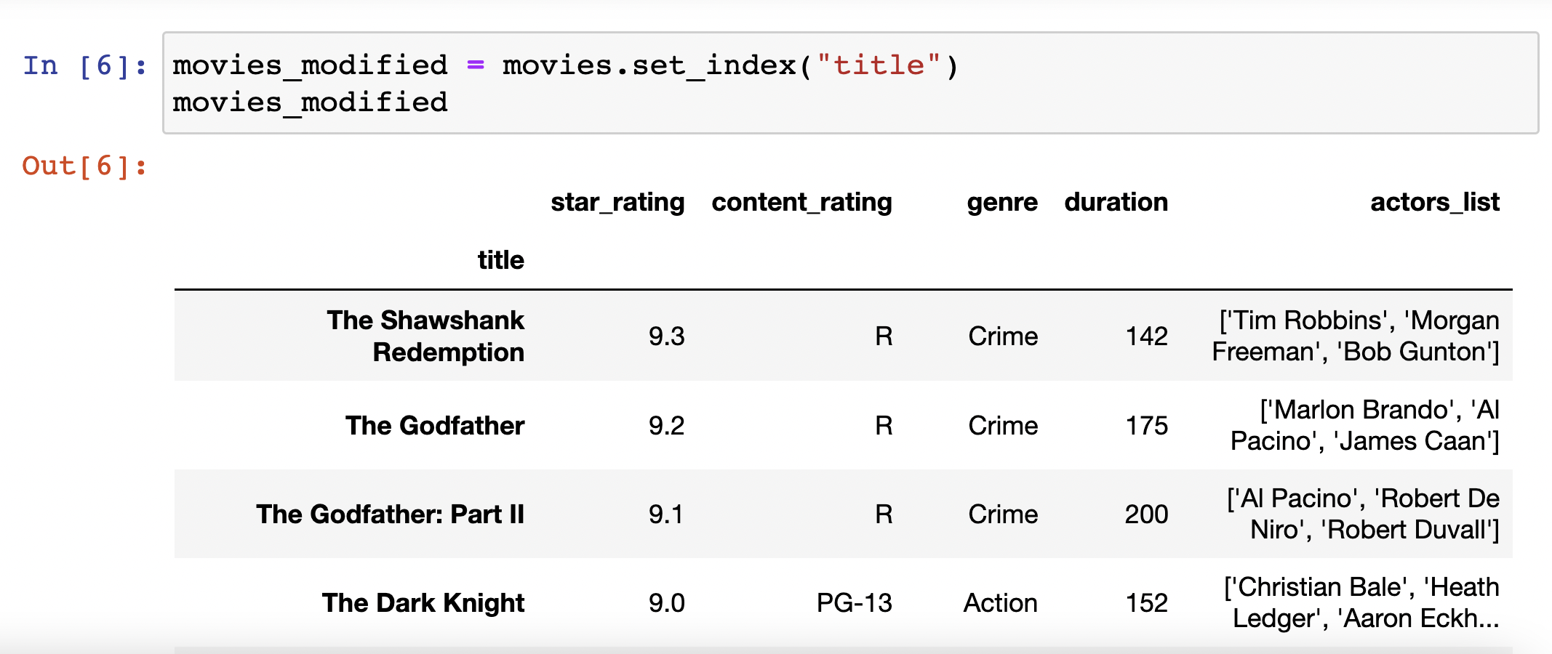
Labels Index
It is often to useful to index by labels instead of positional. For example,
we may prefer to index the movies based the title of the movie instead of integers.
set_index returns a new dataframe with “title” as the row index
label index
Notes:
Crash Course: Cybersecurity

Slide 17
Accessing Rows with loc[]
If the indexing is by labels, .loc[] notation allows us to access rows of a dataframe.
For example:
slicing with labels
When accessing rows, by default, pandas give us all columns.
Note: Unlike slicing in general as well as slicing with integer index(iloc), slicing with loc includes the endpoint. Above, it includes the Dark Knight.
Notes:
Crash Course: Cybersecurity

Slide 18
Filtering Data
Some processes can be used to extract information. For example, data filtering systems are important tools for finding information and recognizing patterns in data.
What if I want to filter my data and only want to look at movies with at least 9.0 rating? You can use the .loc[] notation and insert a filtering boolean condition.
returns all rows satisfying this boolean.
Notes:
Crash Course: Cybersecurity

Slide 19
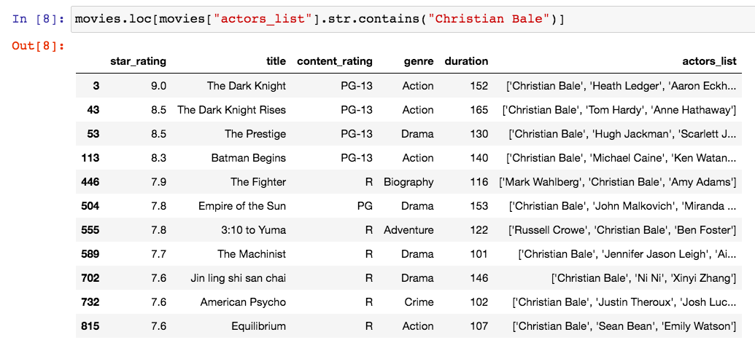
Searching
Search tools are useful for efficiently finding information.
For example, what if I want to watch a highly rated movies that starred Christian Bale? Series.str.contains("string") can be used here.
Notes:
Crash Course: Cybersecurity

Slide 20
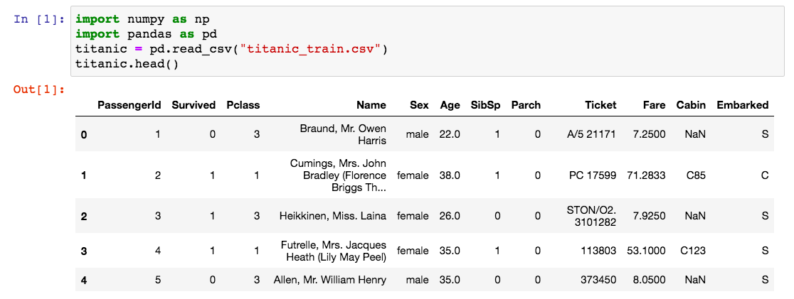
Titanic Dataset Example
On April 15, 1912, during her maiden voyage, the Titanic sank after colliding with an iceberg, killing 1502 out of 2224(32% survival rate) passengers and crew.
Notes:
Crash Course: Cybersecurity

Slide 21
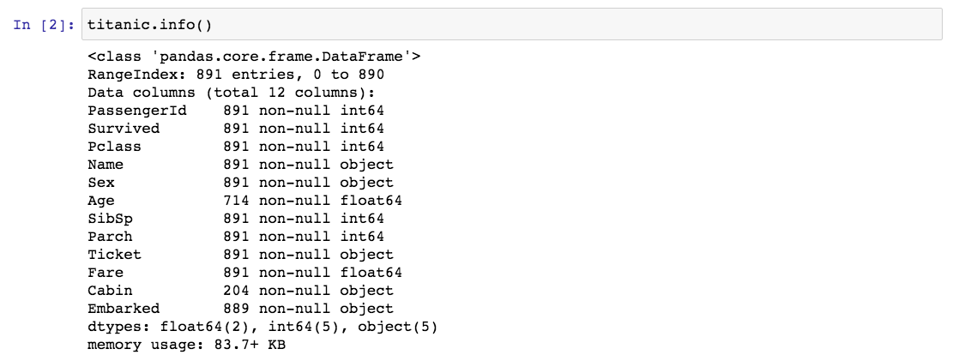
Titanic Dataset Example
Calling the info() method on the dataframe, we can see that this dataset contains incomplete data. For example, Age has only 714 entries(out of 891) and Cabin only has 204 entries(out of 891).
Notes:
Crash Course: Cybersecurity

Slide 22
Cleaning Data
Data sets pose challenges regardless of size, such as:
the need to clean data
incomplete data
invalid data
not uniform(spellings, abbreviations, capitalizations)
the need to combine data sources
Depending on how data were collected, they may not be uniform. For example, if users enter data into an open field, the way they choose to abbreviate, spell, or capitalize something may vary from user to user.
A simple step in the data cleaning process is to make the data uniform without changing their meaning (e.g., replacing all equivalent abbreviations, spellings, and capitalizations with the same word).
For modelling and predicting, data cleaning may involve other steps. See next slides for examples involving the Titanic dataset.
Notes:
Crash Course: Cybersecurity

Slide 23
Cleaning Data
If we are trying to create a model that predicts which passengers survived the Titanic shipwreck. To get a good model, we may clean our data by:
dropping features that contain too many blank or null values(e.g. Cabin)
dropping features that may not have high correlation to our prediction(e.g. Name, PassengerId, Ticket)
Completing features that contain null values but may have high correlation to prediction(e.g. Age contains null values but have high correlation to Surviving)
a) For example, fill in Age null values with median value.
Creating new features from existing features(create new column ”Title” from “Name” to include title of a person, e.g. Mr, Mrs, Miss, Master, etc..)
Models require numerical values; we may need to convert categorical value to numerical values. For example, “Male” to 0 and “Female” to 1, “Non-binary” to 2.
Note: We are down to 8 columns instead of 12.
Notes:
Crash Course: Cybersecurity

Slide 24
Cleaning Data
Pandas allow us to drop columns:
Note: We are down to 8 columns instead of 12.
Notes:
Crash Course: Cybersecurity

Slide 25
Extracting Information
One of the reasons that the shipwreck led to such loss of life was that there were not enough lifeboats for the passengers and crew.
Although there was some element of luck involved in surviving the sinking, some groups of people were more likely to survive than others, such as women, children, and the upper-class.
For example, we can call the groupby() method to group the passengers based on the column Pclass(1 = upper-class, 2 = middle-class, 3 = lower-class) and look at their survivor rate.
Notes:
Crash Course: Cybersecurity

Slide 26
Data
Digitally processed data may show correlation between variables. A correlation found in data does not necessarily indicate that a causal relationship exists.
Additional research is needed to understand the exact nature of the relationship. Often, a single source does not contain the data needed to draw a conclusion. It may be necessary to combine data from a variety of sources to formulate a conclusion.
Combining data sources, clustering data, and classifying data are parts of the process of using programs to gain insight and knowledge from data.
Problems of bias are often created by the type or source of data being collected. Bias is not eliminated by simply collecting more data.
Notes:
Crash Course: Cybersecurity

